Slide 1
Competitive Cyber Security Organization
General – Social Engineering
By attending today’s meeting you acknowledge that you may be photographed or recorded for club use

Slide 2
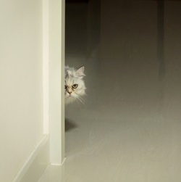

Learning Objectives:
What is social engineering?
Impersonating someone
Building a narrative
I'm in
Prevention

Slide 3
What is Social Engineering?
Exploiting humans to gain entry or information
Humans can be easily manipulated by taking advantage of their natural inclination
Use social norms to your advantage
If your emotions are running high, you are more likely to make a rash decision

Slide 4
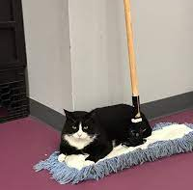
Impersonating Someone
Acting like you belong when you really don't
Essentially creating a character and acting out the role
Fake IT guy, janitor, etc.
Tailgating
This happens all the time even here at PSU, especially in the dorms
Even more susceptible if your hands are full
Coffee cups
The key is to act with confidence

Slide 5
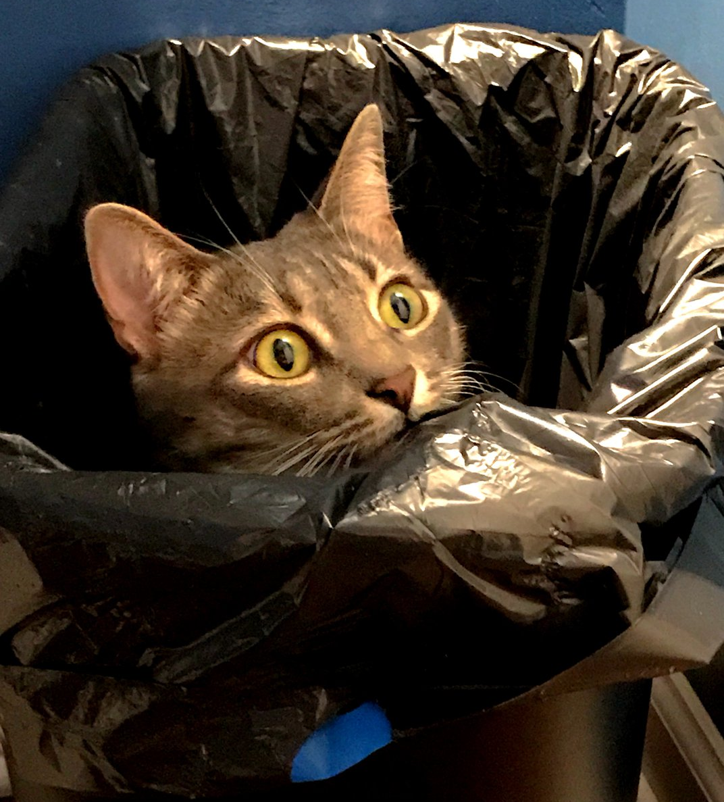
Building a Narrative
More information = better narrative
Dumpster diving
Sensitive information might not have been disposed of properly
Can find device serial numbers, passwords, etc.
Shoulder surfing
Can be from up close or from a distance
These can help build a narrative

Slide 6
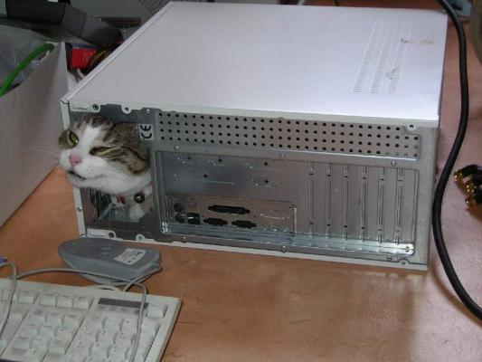
I'm in
After obtaining entry into a building, what next?
Steal information
Employee workstations left unlocked
Creds on post-its
Sensitive documents on desks
Cause chaos
Rubber duckies & Bash Bunnies
Physical access to hardware

Slide 7
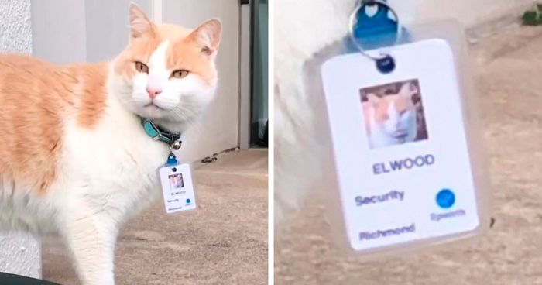
Prevention
Security is all about knowing who to trust
Double check ID/identities
Don't be afraid to question suspicious actors
Make sure information is disposed of properly
Keep desks and workspaces clear
Make others aware
Trust your gut

